Slide 1

CHE 101L
General Chemistry
Lab
Monzil Hossain
BS in Chemistry (New York University),
MS in Chemical Engineering (Columbia University)
Lecturer
Department of Biochemistry and Microbiology
School of Health & Life Sciences
monzil.hossain@northsouth.edu
Office Hours: Thursday 9.30 AM – 10.30 AM (Room SAC 1164)

Slide 2


CHE 101L
Laboratory procedures
Practical laboratory science has many objectives and opinion:
The growth of experience and knowledge in laboratory safety
Experience in scientific instrumentation
Laboratory Attendance
All laboratory classes must be attended except in cases of illness
Laboratory Hours
No student may work in the laboratory outside the allotted class periods without permission from the laboratory supervisor

Slide 3

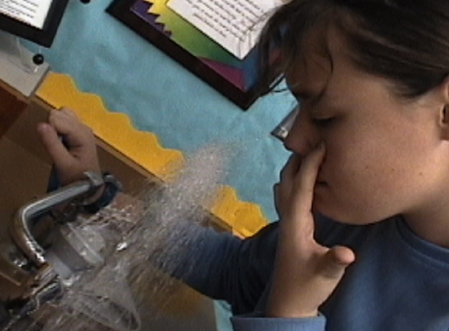
CHE 101L
Safety
Accidents
From time to time accidents do occur in the laboratory
If you receive a chemical burn from acid, alkali, etc., immediately flood the affected area with water
For all accidents, immediately informed to demonstrator

Slide 4
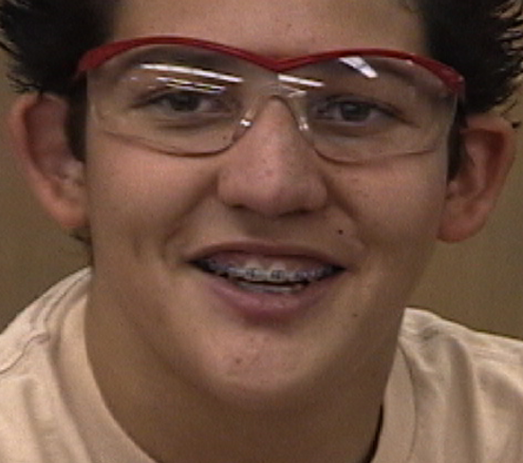
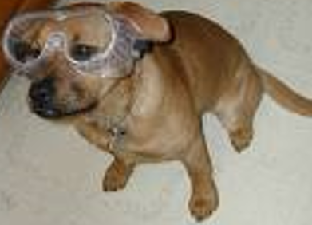
CHE 101L
Allergies
If you are aware that you suffer from allergic reactions to any type of chemical, please inform the Unit Coordinator and your laboratory demonstrator before the commencement of laboratory classes
Safety Glasses
In order to minimise the risk of eye damage, safety glasses must be worn in the laboratory by all persons at all times

Slide 5
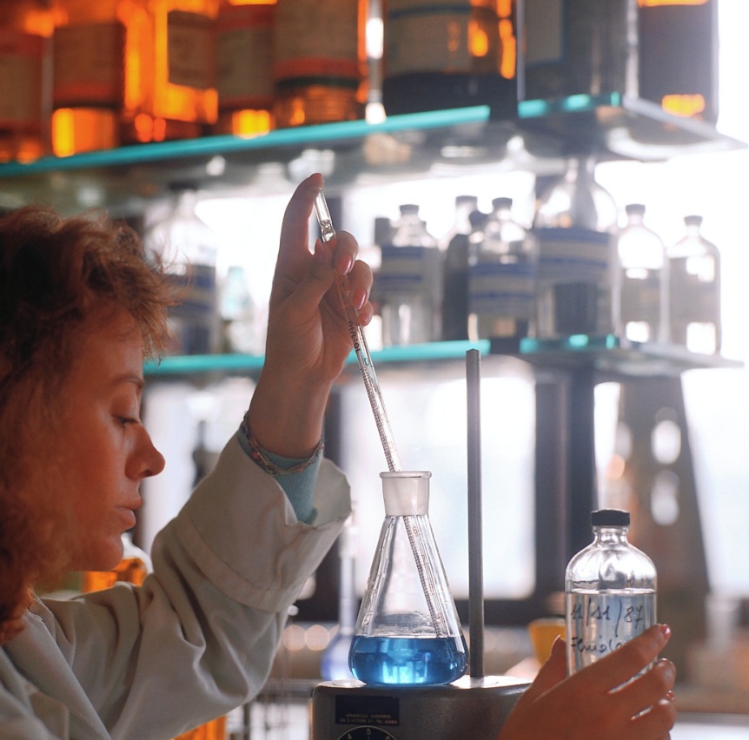
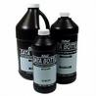


CHE 101L
Chemical Safety
Read all labels twice before removing a chemical from the container
Only use the type and amount of chemical instructed to use
Never touch, taste, or smell a chemical unless instructed by the teacher
Never mix chemicals unless instructed to do so

Slide 6

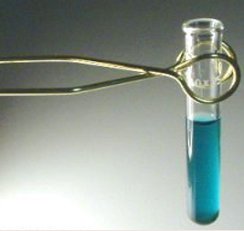
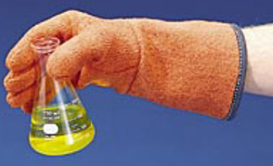
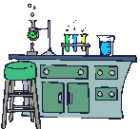
CHE 101L
Toxic and Corrosive Chemicals
Splashing by corrosive chemicals most frequently arises when test tubes are heated too rapidly
Test tubes should never be placed inside a Bunsen flame, but held above it and shaken gently
Concentrated acids should always be diluted by pouring the acid carefully into water; never add water to concentrated acid solutions

Slide 7
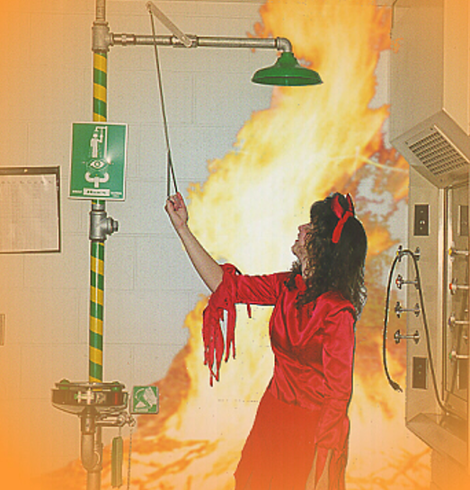

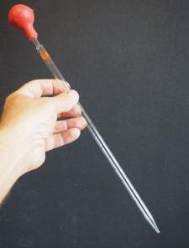
CHE 101L
Toxic and Corrosive Chemicals
If either skin or clothing is splashed with any corrosive liquid, immediately douse with large quantities of water over
No liquids are to be pipetted by mouth; manually operated pipette pumps are available in the laboratory

Slide 8
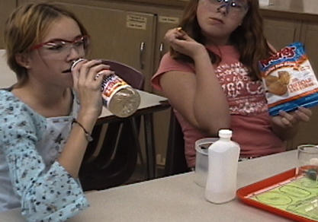

CHE 101L
Forbidden
Smoking, eating and drinking - are absolutely forbidden at all times in the laboratory
Oxidising Agents
Chemicals such as nitric acid and hydrogen peroxide, permanganates, persulfates, chlorates and (particularly) perchlorates, can be very dangerous when in contact with oxidisable materials

Slide 9
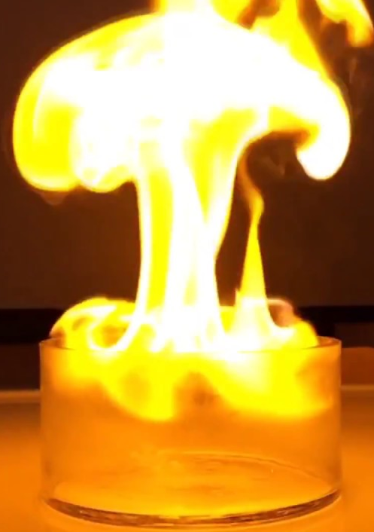

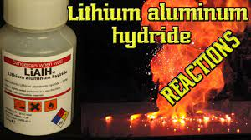
CHE 101L
Reducing Agents
Some reducing agents, such as sodium metal and lithium aluminium hydride, can react with explosive violence on contact with water

Slide 10
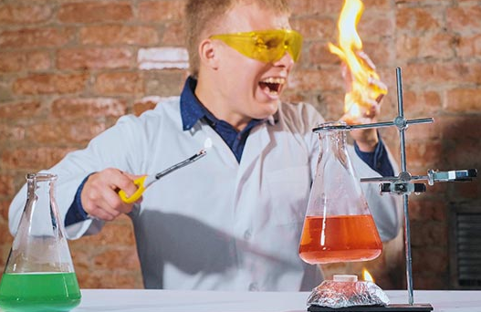
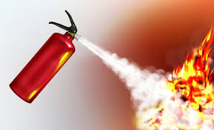
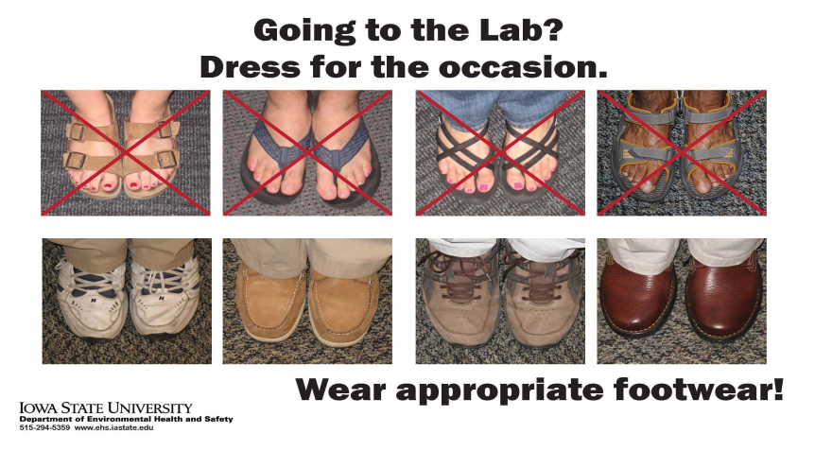
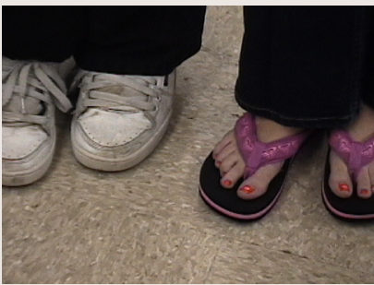
CHE 101L
Fire
Fires can arise from incompletely extinguished matches or spills being placed in waste paper baskets
For fire-fighting, every laboratory room is provided with Bromochlorodifluoromethane (BCF) or carbon dioxide extinguishers
Clothing
You must be adequately clothed to be admitted to a laboratory. Covered shoes (not sandals or thongs) must always be worn.

Slide 11


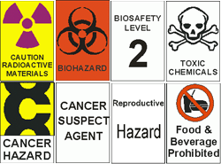
CHE 101L
Glassware
Dispose of broken glassware safely after notifying your demonstrator
Summary of important rules
You MUST: wear shoes, wear safety glasses and a laboratory coat, tie back long hair, report all accidents immediately
You MUST NOT: drink, eat, smoke, work unsupervised, use volatile solvents near a flame

Slide 12
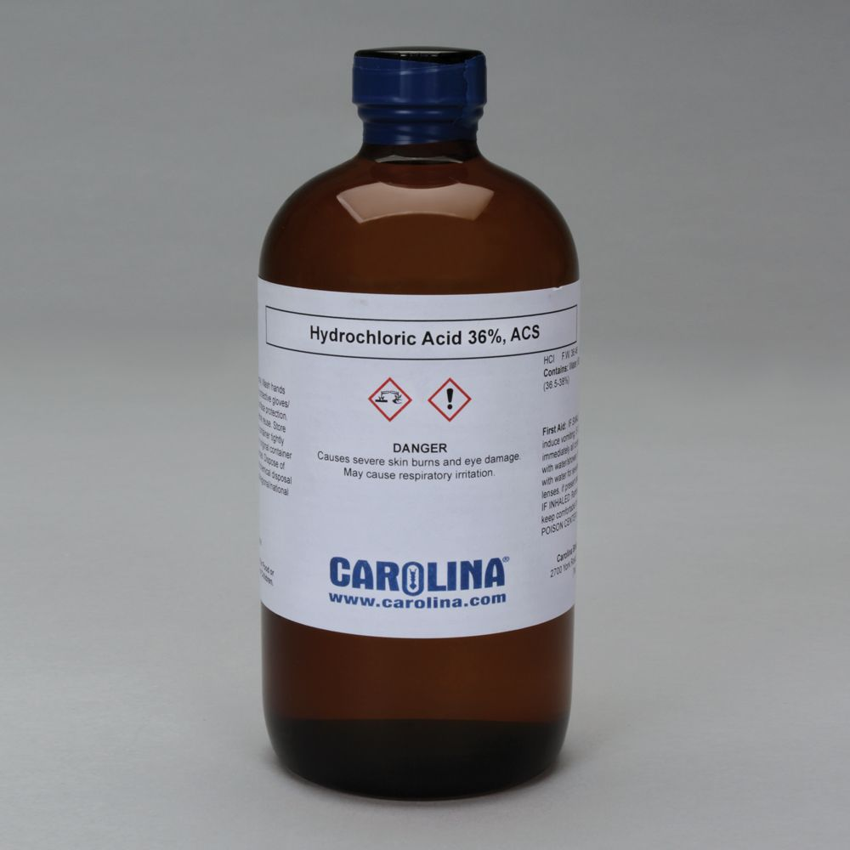
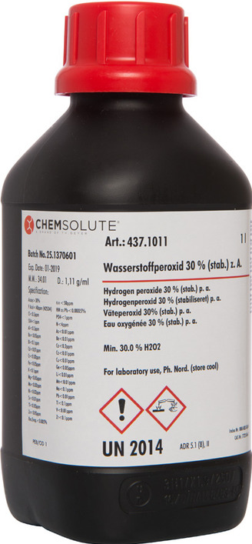

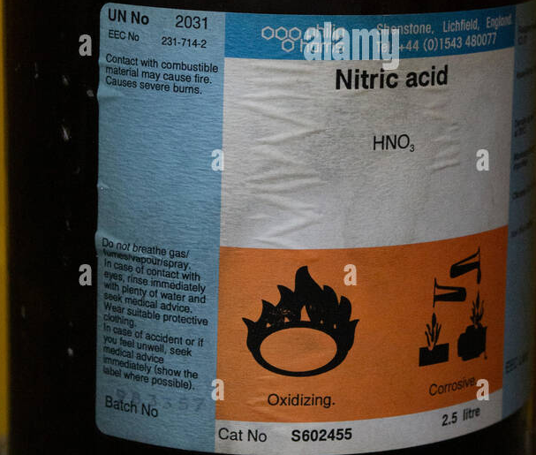
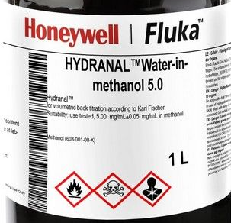
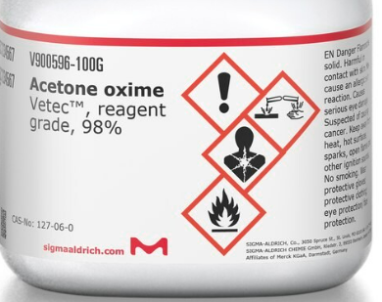
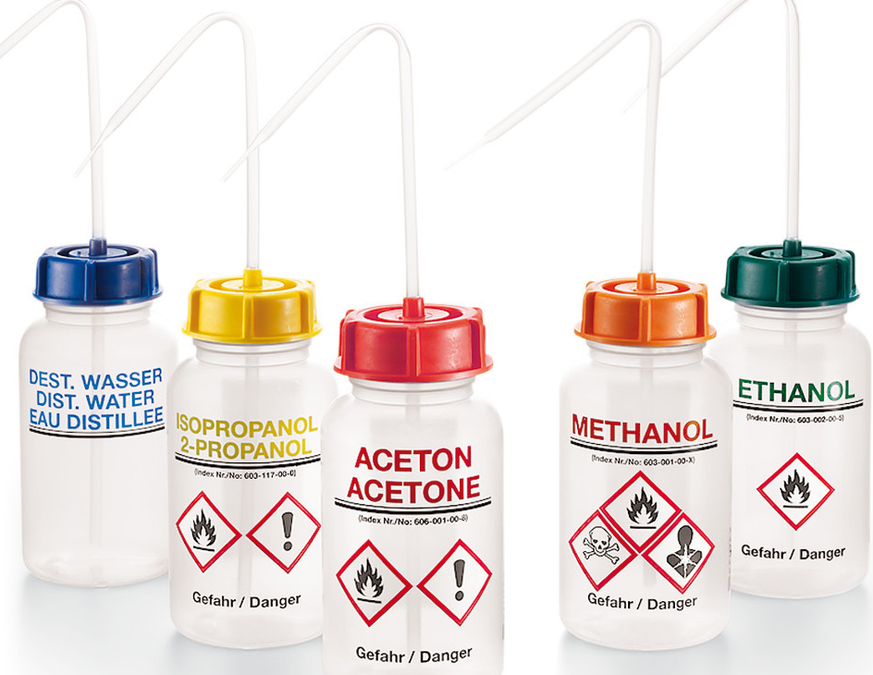
CHE 101L
Chemical Hazard Symbols

Slide 13
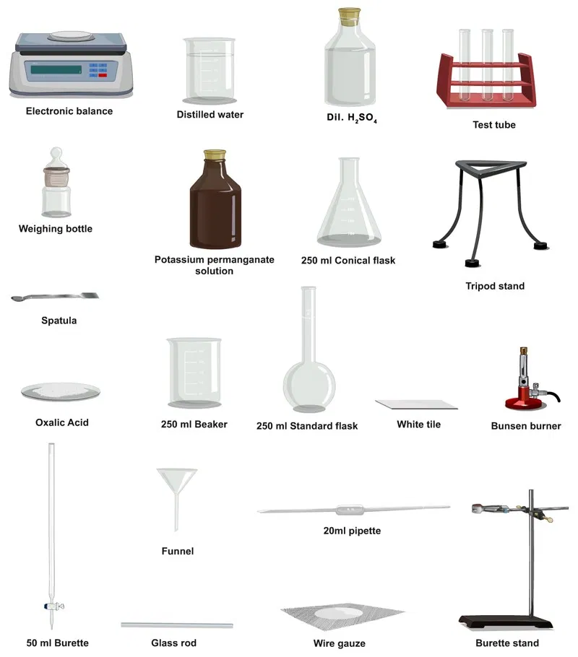
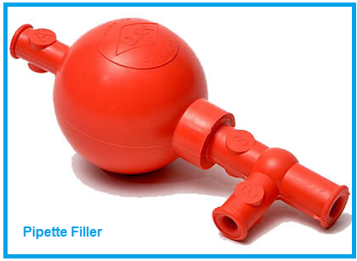

CHE 101L
Glass Apparatus
& Instruments

Slide 14
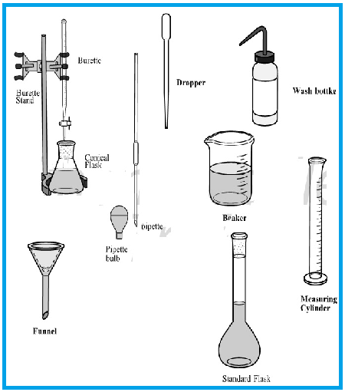
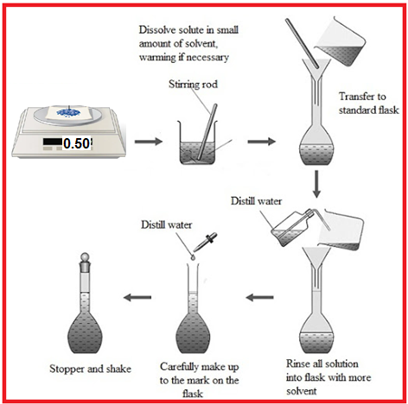
CHE 101L

Slide 15
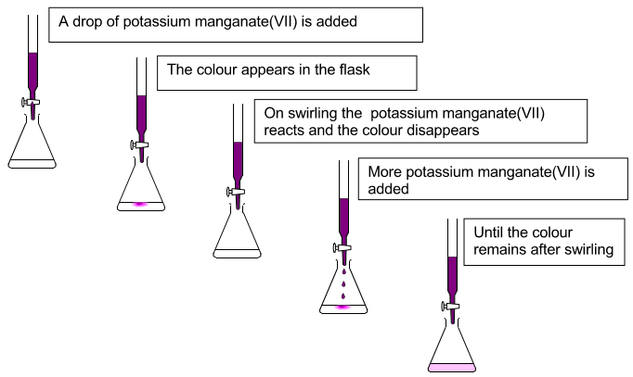
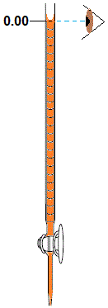
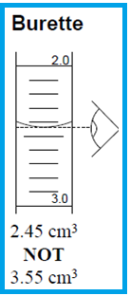
CHE 101L

